Slide 1

TWO-WAY DIGITAL PAGING SYSTEM USING SDRS
BY SPECACK
230147L - DILHARA D S
230508V - RAHUL B
230585C - SARUKA U
230654M - UMAIR A

Slide 2

Project
Requirements
Short message delivery system using digital modulation (QPSK)
Unique user addressing
Acknowledgment (ACK) mechanism for reliable communication
CRC-based error detection and rejection of corrupted packets
Basic GUI for message composing

Slide 3

One-Way Functional Block Diagram
Packetization
QPSK
Modulation
bladeRF
Transmission
Text
Acknowledgment
CRC Validation
& Payload
extraction
Recovery &
Demodulation
bladeRF
Reception
Text

Slide 4
Structure of a Packet
(PAYLOAD)
DESTINATION
ADDRESS (1B)
SEQUENCE
NUMBER (1B)
NONCE
(8B)
CIPHER
TEXT (32B)
CRC-32
(4B)
PREAMBLE (128 B)
Preamble: Helps the receiver detect the start of a new packet, allows the SDR receiver to synchronize timing and carrier frequency before reading actual data
Destination Address: Indicates which specific device the packet is meant for and enables multi-node communication
Sequence Number: Provides a unique ID for each packet, and helps with tracking the acknowledgement part of the digital communication system.
Nonce: “Number used once”, for AES encryption and prevents replay attacks and ensures freshness of communication
Cipher Text: Contains the actual encrypted message from the user
CRC-32: Cyclic Redundancy Check value used to detect errors in incoming packets, computed over sequence number, nonce and the cipher text.

Slide 5
Structure of a Packet
(ACK)
NEXT
SEQUENCE
NUMBER (1B)
PIGGYBACKED
PAYLOAD
(40B)
DESTINATION
ADDRESS (1B)
CRC-32
(4B)
PREAMBLE (128 B)
Preamble: Helps the receiver detect the start of a new packet, allows the SDR receiver to synchronize timing and carrier frequency before reading actual data
Destination Address: Indicates which specific device the acknowledgement packet is meant for and ensures the original sender processes the acknowledgement.
Next Sequence Number: Indicates the next expected sequence number from the sender and confirms that the previous packet was received successfully.
Piggybacked Payload: Allows the receiver to send extra information or a short return message together with the ACK
CRC-32: Ensures the ACK has not been corrupted during transmission.

Slide 6
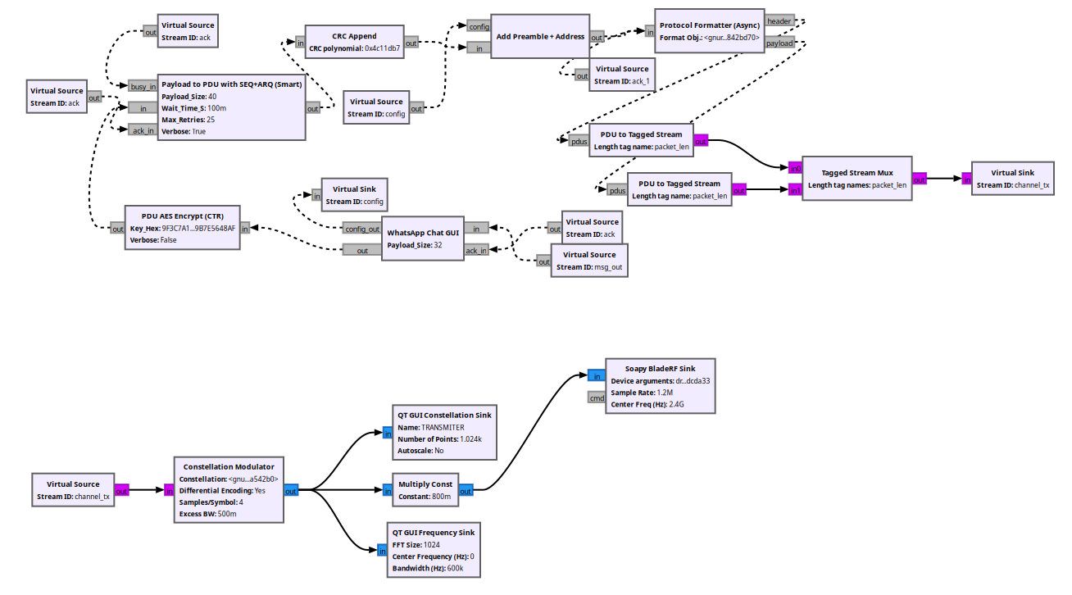
Transmitter

Slide 7
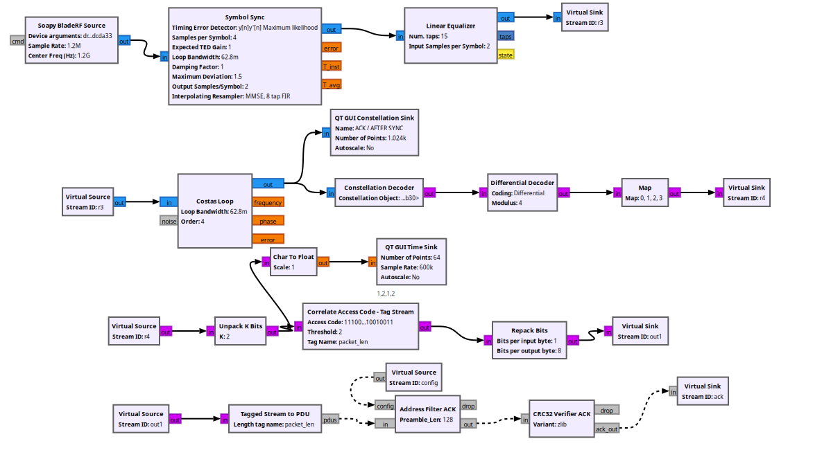
ACK Receiver Block

Slide 8
Functionalities of Transmitter Blocks
WhatsApp GUI : Custom Block which is a GUI with multi node transmission functionalities, allowing users to communicate with the desired user, also allows one user to receive and send messages at the same time.
PDU AES Encrypt: Takes the 32 byte PDU and encrypts the payload using AES in CTR mode and outputs a new PDU with nonce and ciphertext.
Payload to PDU with SEQ+ARQ (Smart) : Adds the sequence number to the packet for ARQ and also contains parameters for timeout period and maximum retries before moving onto the next packet, also prioritizes the ACK transmission before the payload transmission.
CRC Append: Appends CRC-32 to the end of the packet which is calculated using the payload and the sequence number.
Add Preamble + Address: Appends the destination address and the preamble to the packet
Protocol Formatter: Frames each packet with a header (containing sync word, addressing, etc.) and payload, ensuring proper synchronization and identification.
PDU to Tagged Stream: Converts packet-based data (PDUs) into tagged streams for modulation, and back again at the receiver. This allows GNU Radio blocks to handle both continuous streams and discrete packets.
Constellation Modulator: Maps digital bits into complex QPSK symbols for RF transmission.
Symbol Sync: Aligns the received signal samples with symbol timing to reduce inter-symbol interference
Linear Equalizer: Compensates for channel distortions and multipath effects, improving signal quality.

Slide 9
Functionalities of Transmitter Blocks
Costas Loop: Corrects carrier frequency and phase offsets in the received signal, enabling proper demodulation.
Constellation Decoder: Converts received QPSK symbols back into digital bits.
Differential Decoder: Removes phase ambiguity introduced during modulation/demodulation.
Map, Unpack: Reconstructs the bitstream into meaningful packets, preparing them for higher-layer processing
Address Filter ACK: Removes the preamble in the packet and checks if the address is correct and removes that as well forwarding the rest of the packet.
CRC32 Verifier ACK: Checks CRC-32 and forwards only the next sequence number if CRC check passes.

Slide 10
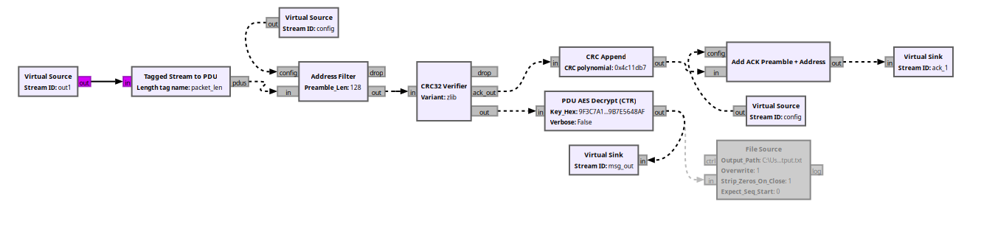
Message Receiver Block

Slide 11
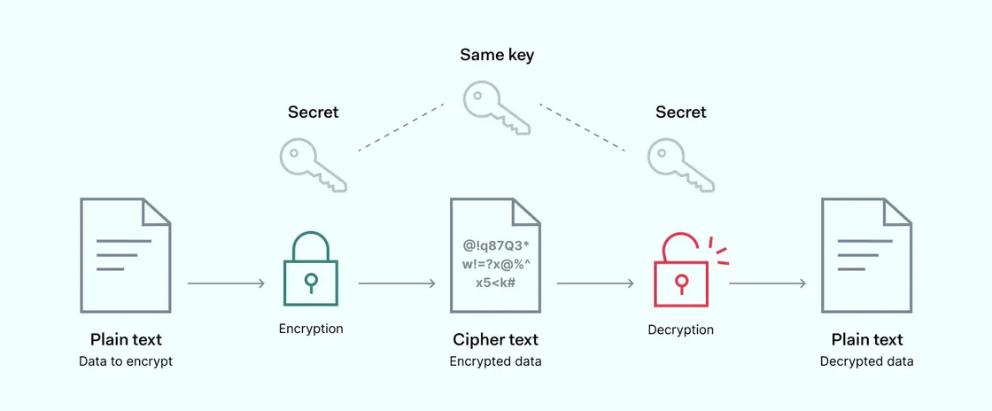
Implemented Optional
Features
AES-CTR Encryption
A symmetric key encryption algorithm used to secure digital data.
Operates on fixed-size blocks (128 bits) using 128, 192, or 256-bit keys.
Encrypts data by performing substitution, permutation, and mixing operations over multiple rounds.
CTR (Counter) mode allows encrypting variable-length messages and enables stream-like encryption.
Widely used in applications like secure messaging, file encryption, and network communications.

Slide 12
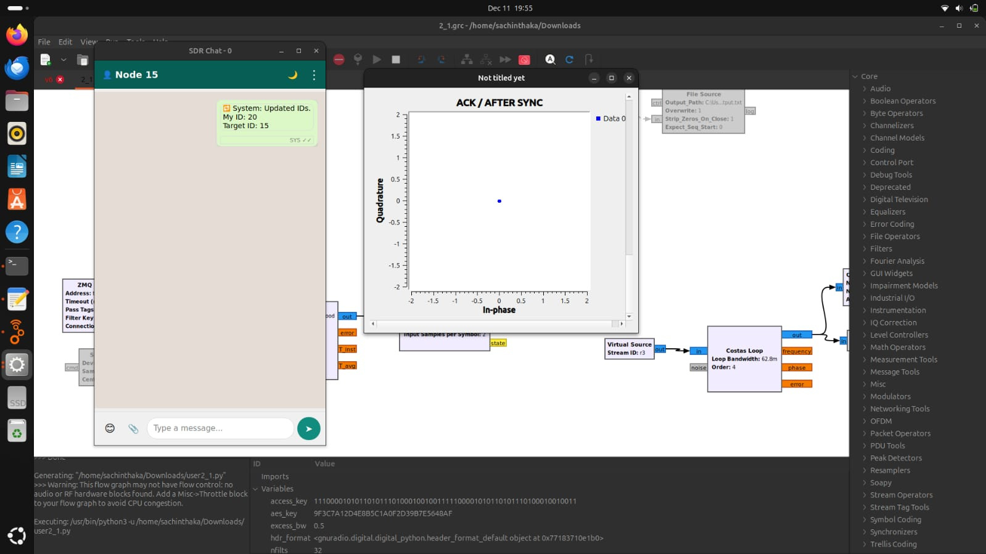
GUI for Message Composing
User-Friendly to easily compose messages similar to WhatsApp.
Provides the status of ACK by the use of colored ticks next to messages.
Easy to select the User it wants to communicate.
Can send text files

Slide 13
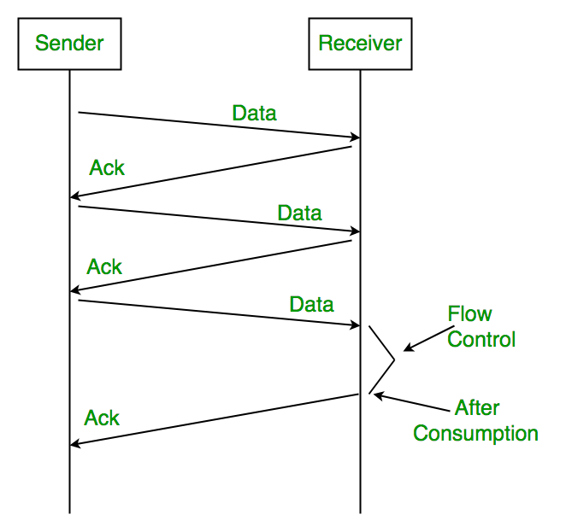
Selected Methodologies
Stop-and-Wait ARQ
Each frame carries a destination address
The receiver checks for the correct address
If the address matches, the receiver sends an ACK back, acknowledging the successful packet transmission.
The sender waits looking for the ACK, if a certain timeout passes and still the ACK is nowhere to be found, the sender retransmits the frame assuming it got lost.

Slide 14
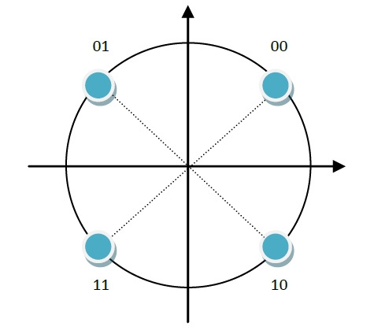
WHY QPSK?
Better Data Rate with limited bandwidth
QPSK carries 2 bits per symbol, doubling the data rate compared to BPSK while maintaining the same bandwidth.
For a messaging system, where throughput matters (ACKs), QPSK is very efficient.
Tradeoff between Complexity and Performance
Easier to implement in GNU Radio and on bladeRF while being simpler than other higher-order schemes.
Strong Performance under noise
Has excellent bit error rate in low or moderate SNR conditions.
Very ideal for lab environments and very robust.

Slide 15
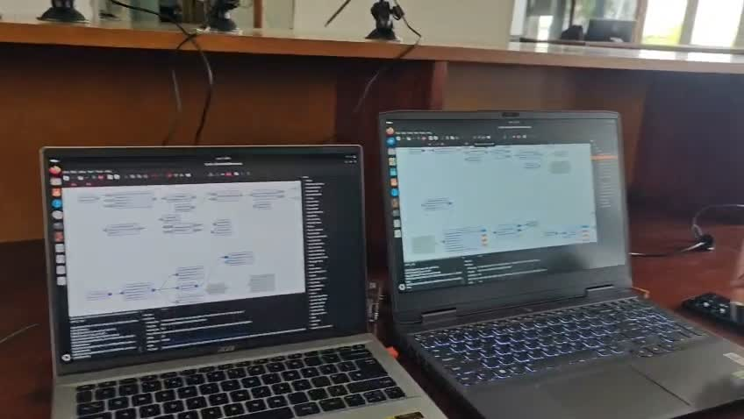
FINAL TESTING

Slide 16
Thank you very much!

